Slide 1
*CAPSTONE PROJECT* E-COMMERCE COMPANY
OPEN A WAREHOUSE
************
PITCH BY: TANUJ KUMAR

Slide 2
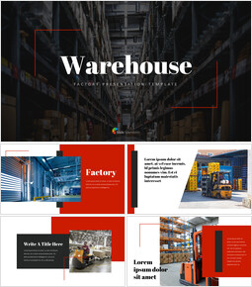
* AGENDA *
Warehouse operations defined
Examples of warehouse operations
Fundamentals of warehouse
Identification of the requirements and limitation regarding the warehouse system design
Select location
Research and Analyze
Finalize a concept
Judgments

Slide 3
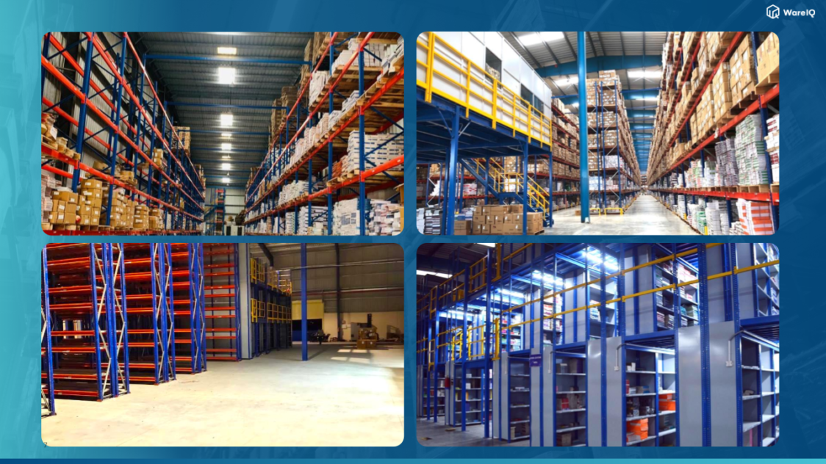
* APPROACH *
Decide the concept for the warehouse
Investment plan for opening a warehouse
Determine the warehouse space needed
Create a list of essential warehouse equipment
Need to create a strategy for collecting and aggregating the appropriate data
Host a soft opening

Slide 4

* KEY PARAMETERS *
New orders
Packaging supplies
Outgoing orders
Shipping levels
Return and Exchange
Style of warehouse
Money spending tendency
Filling major gaps

Slide 5
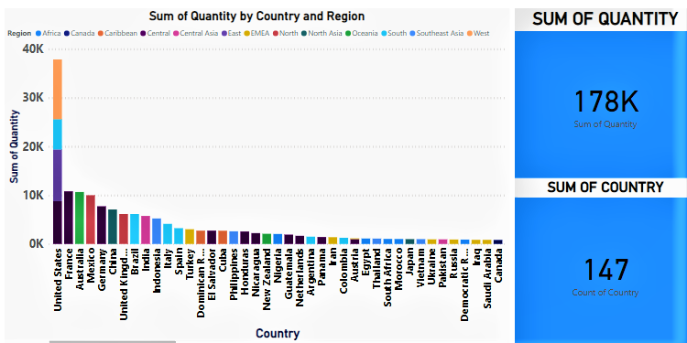
* ANALYSIS BY THE CHARTS *

Slide 6
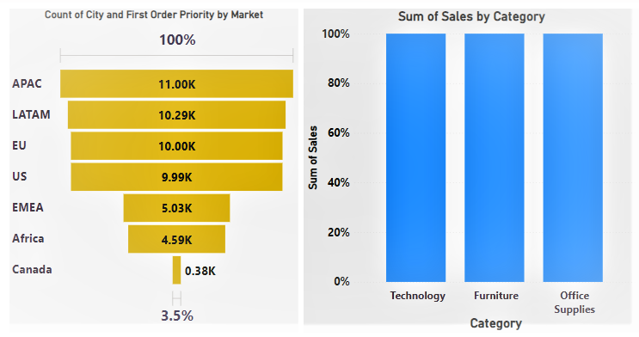

Slide 7
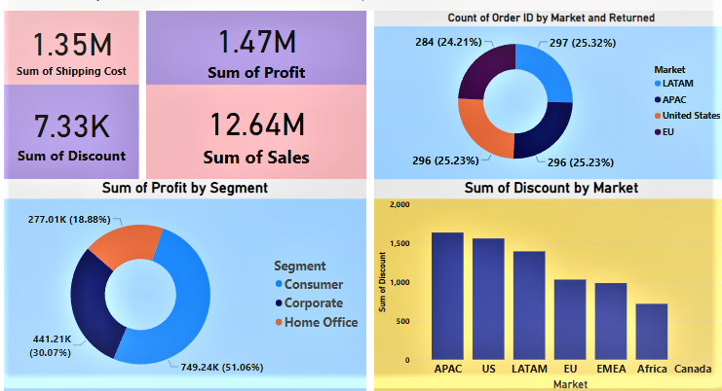

Slide 8
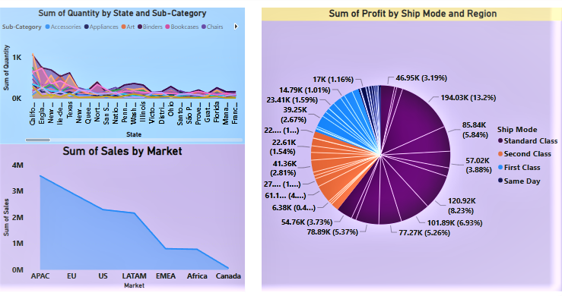

Slide 9

INSIGHTS:-
Sale more products
Reduce labour cost and shipping cost
Increase profit in market
Reducing transportation costs
Manage courier partners
Reducing sales patterns
Quickly and efficiently work will be needed to do
CONCLUSION:-
Warehouse makes it easier to receive, store and distributes the goods as all the goods are stored in a central location. This helps in reducing transportation costs and increasing the value of goods as products are available at the right place, at the right time.
It is clearly shows that Canada has very low sales and we have identify causes of low sales, it might be :- Low population, Issues of demand and supply, High transportation costs or high labour costs.
Good inventory and warehouse management for your online store can help you to save money and time while meeting customers expectations.
It can be included that the investment for warehouse will be profitable business. It's a good opportunity to earn huge profits on this business.

Slide 10



